Slide 1


Fifteen Puzzle Game
Sarah mustafa,

Slide 2
Introduction
Fifteen Puzzle Overview:
An engaging tile-based puzzle where the goal is to rearrange numbered tiles into numerical order.
Each move involves sliding a tile into the empty space, progressively solving the puzzle.
Collaboration of Technologies:
We Seamlessly integrated HTML, CSS, and JavaScript for a cohesive and dynamic user experience.
Efficiency and Simplicity:
We Leveraged the strengths of each technology to create an efficient, responsive, and visually appealing puzzle game.

Slide 3
Tech Stack
HTML (Hypertext Markup Language):
Used for creating the structural foundation of the Fifteen Puzzle game.
Defines the layout and arrangement of elements on the web page.
CSS (Cascading Style Sheets):
Employed for styling and visual presentation of the game interface.
Defines the colors, fonts, and overall aesthetics of the puzzle.
JavaScript:
Utilized for implementing interactive game mechanics.
Powers the shuffling of tiles and facilitates user interactions.

Slide 4
Game Initialization
Setting Up the Initial Puzzle Board:
The game starts by setting up the initial configuration of the puzzle board.
Tiles are arranged in numerical order with one tile missing.
Displaying the Background Image:
A selected background image is applied to create a visually engaging puzzle board.
In this project, the background image is applied to all tiles for a cohesive look.

Slide 5
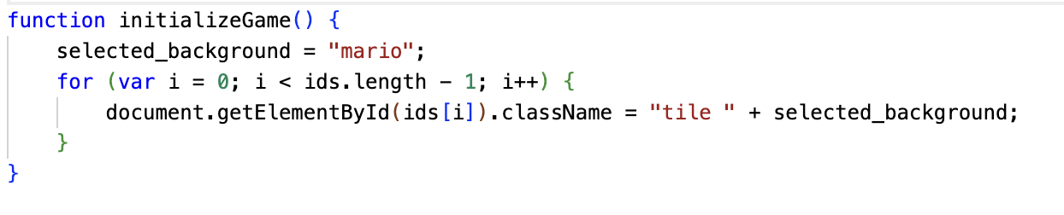
Game Initialization

Slide 6
Shuffling the Puzzle
Algorithm for Randomizing the Puzzle:
The game incorporates a shuffling mechanism to create a randomized starting position.
A loop iterates through a set number of shuffling steps, ensuring a well-mixed puzzle.
Ensuring Solvability:
The shuffling algorithm is designed to guarantee that the puzzle remains solvable.
The puzzle is shuffled by making valid moves, maintaining solvability conditions.
The shuffleBoard function randomizes the puzzle configuration.
A set number of random valid moves are made to shuffle the tiles.
The display is updated to reflect the new shuffled state.

Slide 7
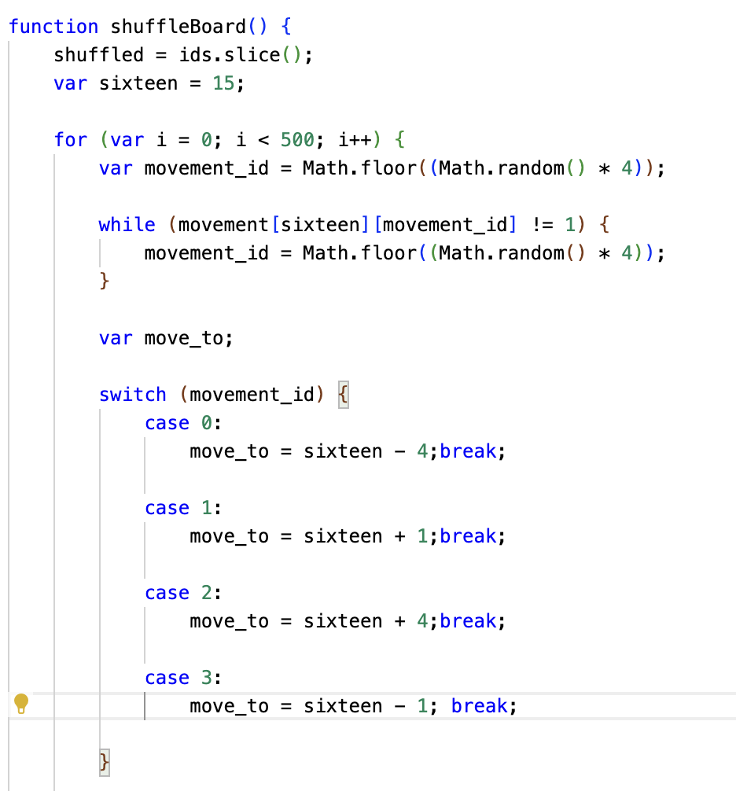
Shuffling the Puzzle

Slide 8
Displaying the Puzzle
Displaying the Shuffled Puzzle:
The displayBoard function renders the shuffled puzzle on the user interface.
It dynamically creates HTML elements representing each tile and updates their positions based on the shuffled configuration.
Interactive Clickable Tiles:
Clickable tiles are determined by the valid moves from the empty space.
These tiles are visually highlighted and made interactive, allowing players to make valid moves by clicking.

Slide 9
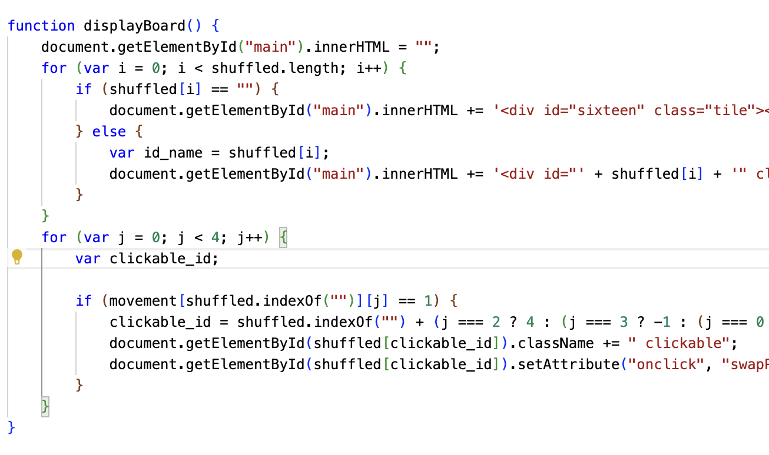
Displaying the Puzzle

Slide 10
Displaying the Puzzle
Displaying the Shuffled Puzzle:
The displayBoard function renders the shuffled puzzle on the user interface.
It dynamically creates HTML elements representing each tile and updates their positions based on the shuffled configuration.
Interactive Clickable Tiles:
Clickable tiles are determined by the valid moves from the empty space.
These tiles are visually highlighted and made interactive, allowing players to make valid moves by clicking.

Slide 11
User Interaction
The game enables user interaction through tile clicking. Each click swaps the clicked tile with the adjacent empty space. User moves are tracked to monitor progress and determine when the puzzle is solved.
User Moves: - The user interacts with the game by clicking on clickable tiles to make moves. - Click events are handled by the swapPieces function.
The swapPieces function: - Is called when a clickable tile is clicked. - Swaps the clicked tile with the empty tile. - Increments the `moves` variable. - Calls the `displayBoard` function to update the game board.

Slide 12
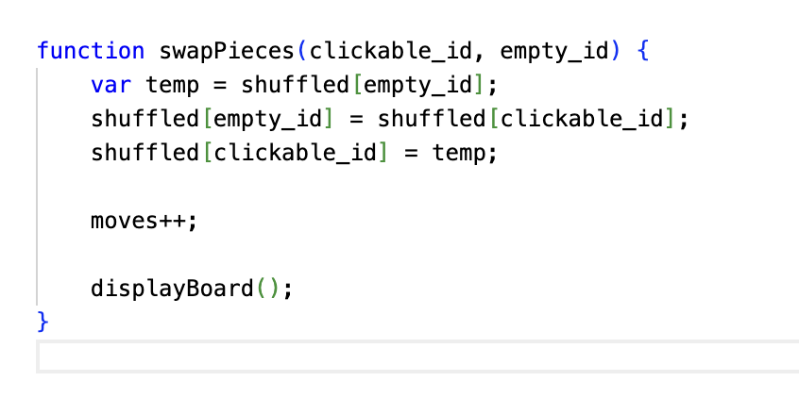
User Interaction

Slide 13
CODE SUMMERY
The Fifteen Puzzle Game is implemented successfully using HTML, CSS, and JavaScript. - The game provides an interactive and visually appealing experience for users.
The project combines HTML for structure, CSS for styling, and JavaScript for interactivity. - The `initializeGame` function sets up the initial puzzle board, and `shuffleBoard` randomizes the puzzle for a new game. - User interactions are handled by the `swapPieces` function, which swaps tiles and updates the board. - The `displayBoard` function renders the shuffled puzzle on the UI, making clickable tiles interactive.

Slide 14
THANK YOU!

